Slide 1
COIN BASE MOBILE CHARGER

Slide 2

Contributors
Principal:
Mr Dr. V. S. Bandal
Group members:
Ajay More
Siddhant Kalamkar
Siddharth Kalamkar
Niyamat Choudhary
HOD:
Mr U. V. Kokate
Guide:
Mrs A. A. Shaikh
Government Polytechnic Pune

Slide 3
OUTLINE
Introduction
Establishing the problem and motivation
Project Module
Algorithm and Flow chart
Block Diagram
Description of block diagram
Required component
Connection Diagram
Working Principle
Benefits
Application
Future enhancement
Conclusion
References

Slide 4
Introduction
Now a day’s mobile phones are become ineluctable part . Power supply is integral part of all electronic systems. Most of the work are done through mobile phones on daily basis, so charging is the basic requirement to operate them. We always carry the mobile with us but in this busy world 3 out of every 5 people doesn’t carry charger or any back up with them, at that time this project will help you to charge your device for the particular amount of time on coin insertion. You can charge anytime and anywhere.

Slide 5
Establishing the problem and motivation
Now a days , mobile phones became integral part of our Indians. We are depend on mobile phones from morning alarm to ordering the dinner. In Such modern, life our phone battery is low in emergency and we are out of home ,there is no facility in India to provide you to charge your device. In Japan there are charging station at different places. So we decided to design such device which allow the Indians to charge their phones at outside by inserting the coin . this service can be available at railway station , bus stop, mall, colleges, office, Roads . This service can become the good business also .

Slide 6
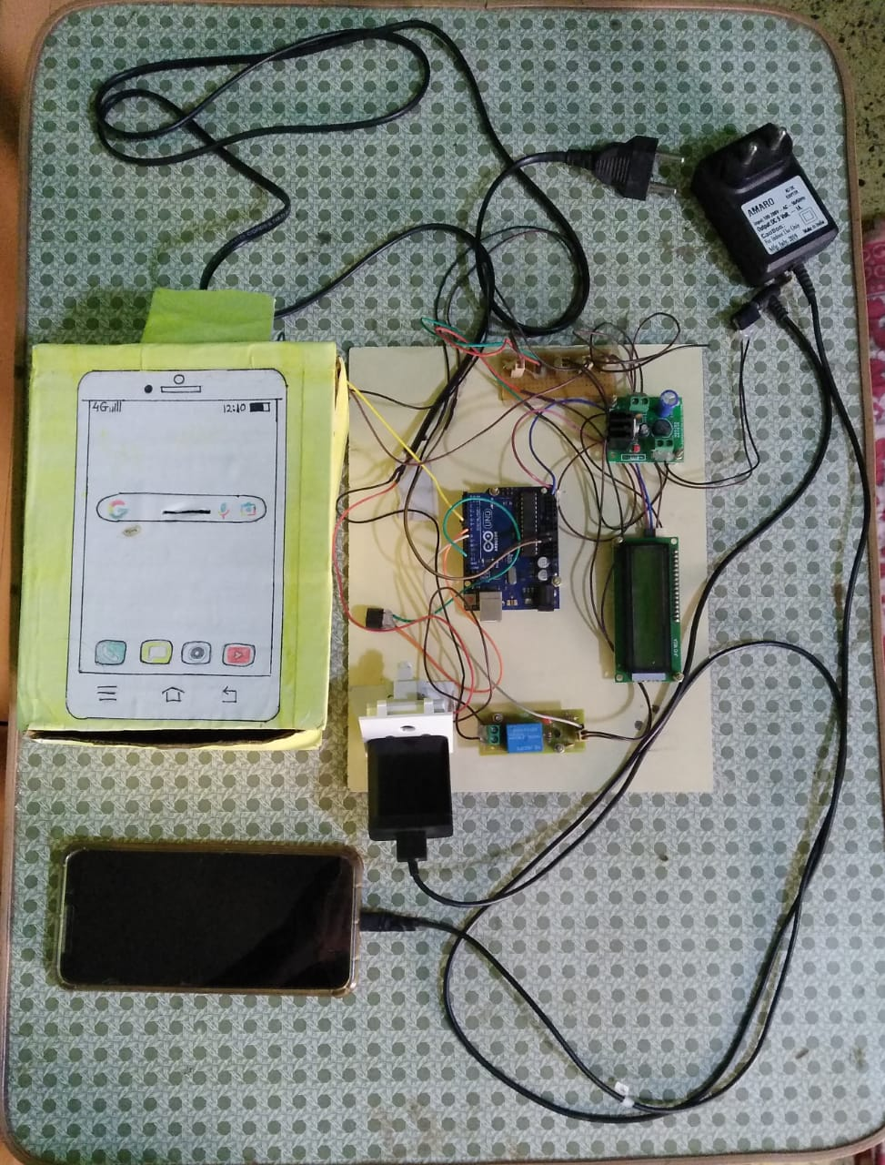
Project Module

Slide 7

Algorithm
Flow Chart
Start
Insert The Coin
Detection of coin
If coin detected pass signal to microcontroller
Else refund the coin
Microcontroller set the time of charge
LCD display message and time of charging
Mobile charge for assigned time
Stop the charging when time is over
Reset the device
END
Start
Insert the Coin
Yes
Detection of Coin
No
Pass Signal to Microcontroller
LCD display the Assigned time for charge
Mobile is charging
No
Is time over
Yes
Stop Charging
End

Slide 8
Block Diagram
Input
Mains
Insert Coin
Transformer
ARDUINO
[UNO]
Coin Sensor
Controller
Output
Rectifier
LCD Display
Regulator
Relay
[Micro Controller]
Charger Driver
Universal Mobile Charger
Mobile

Slide 9
Description Of Block diagram
Input Stage
Insertion slot
Sensor – (IR sensor) attached to coin insertion box accept the coin, controlled by microcontroller
Controller
Transformer(Step-Down)
Rectifier(Convert AC-DC)
Regulator(5V)
Output & Display
LCD(16X2)
Relay
Charger Driver
Universal Mobile Charger
Mobile(Load)

Slide 10
Required Components
Hardware Requirement
ATMEGA328 Microcontroller (Arduino UNO)
IR Proximity Detector (Coin Detector)
16x2 LCD Display
Electric switch
Relay
Regulated Power Supply
Software Requirement
ARDUINO IDE
EMBDDED CPP CODE
Proteus Simulator

Slide 11
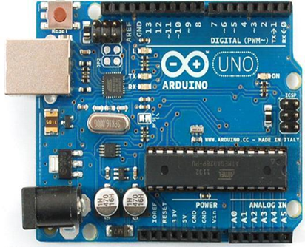
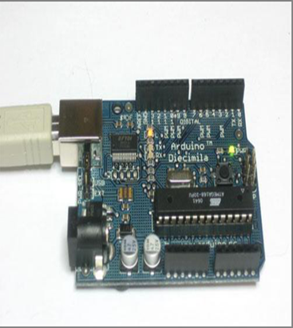
Arduino UNO
Arduino Uno is a microcontroller board based on the ATmega328P (datasheet).
Features
Microcontroller: ATmega328
Operating Voltage: 5V
Digital I/O Pins: 14
Analog Input Pins: 6
Flash Memory: 32 KB of which 0.5 KB used by bootloader.
Clock Speed: 16 MHz
Length: 68.6 mm
Width: 53.4 mm
Weight: 25g

Slide 12
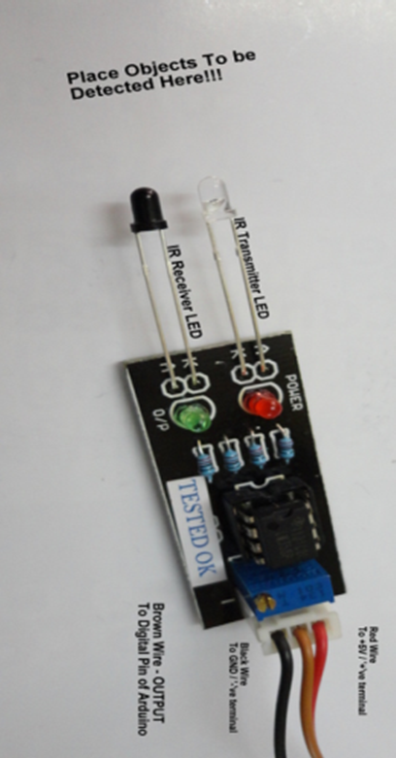
IR Proximity Detector (InfraRed Detector)
An infrared (IR) sensor is an electronic device that measures and detects infrared radiation in its surrounding environment.
There are two types of infrared sensors: active and passive.
Features
5V DC Operating Voltage.
I/O pins are 5V and 3.3V compliant.
Range: Up to 20cm.
Adjustable Sensing range.
Built-in Ambient Light Sensor.

Slide 13
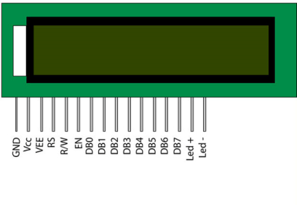
LCD Display(16x2)
A liquid crystal display (LCD) is a thin, flat display device made up of any number of color or monochrome pixels arrayed in front of a light source or reflector.
By connecting I2C connector, We need to connect 4 pins instead of 12 pins.
Features
Operating voltage is 4.7V-5.3V.
It has 2 rows.
Each row can produce 16 characters.
Every character can be built with a 5x8 pixel box.
Has Blue & Green Backlight.

Slide 14
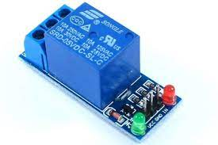
Relay
A relay is an electrically operated switch. Relays allow one circuit to switch a second circuit which can be completely separate from the first.
It is a bridge between arduino and high voltage device.
Pins
COM (common)
NC (normally closed)
NO (normally open)
VCC
GND
Input

Slide 15
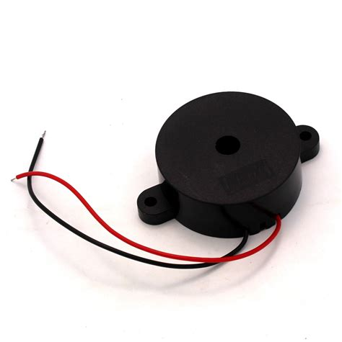
Buzzer
An arduino buzzer is also called a piezo buzzer. It is basically a tiny speaker that you can connect directly to an Arduino.
You can make it sound a tone at a frequency you set. The buzzer produces sound based on reverse of the piezoelectric effect.
Pins
GND
Signal

Slide 16
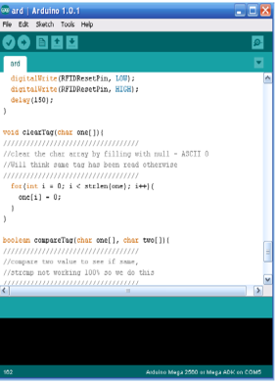
ARDUINO IDE
The open-source Arduino Software (IDE) makes it easy to write code and upload it to the board. It runs on Windows, Mac OS X, and Linux.
The environment is written in Java and based on Processing and other open-source software.
Features of Arduino IDE
Sketch Editing Tools
Serial Monitor
Sketches Management
User Preferences
Fix Encoding & Reload
Board Selection & Management

Slide 17
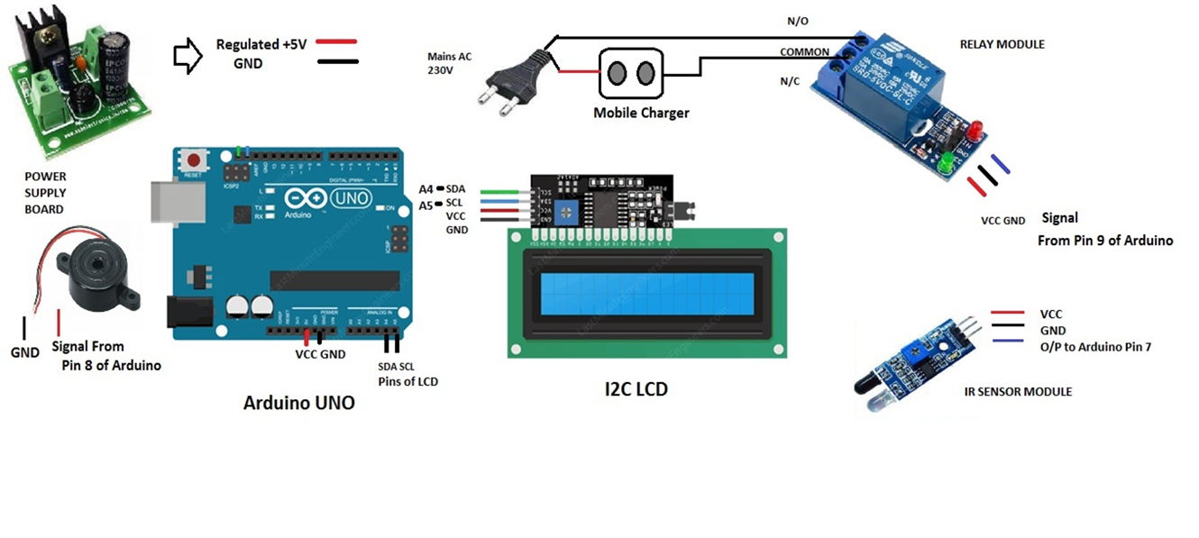
Connection Diagram

Slide 18
Working of Module
Step 1 : LCD Instruction
According to instruction display on LCD screen
i.e Insert coin , user insert coin into the coin box.
Step 2 : Coin Detection
When coin is inserted into coin box IR sensor detect coin and send HIGH/1 signal to arduino pin 8.
Otherwise, It always send LOW/0 signal to arduino pin 8.

Slide 19
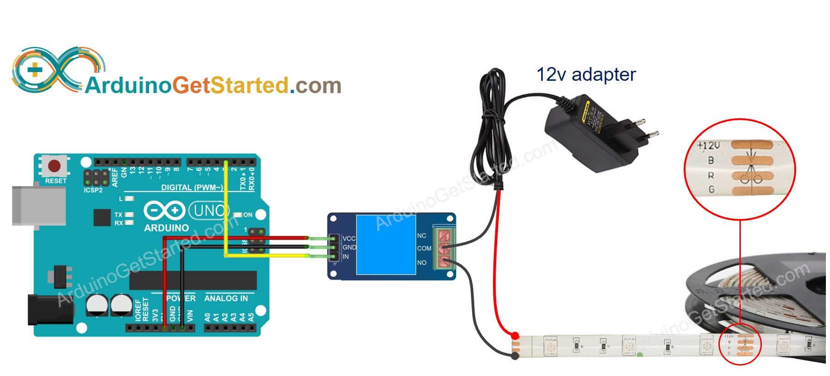
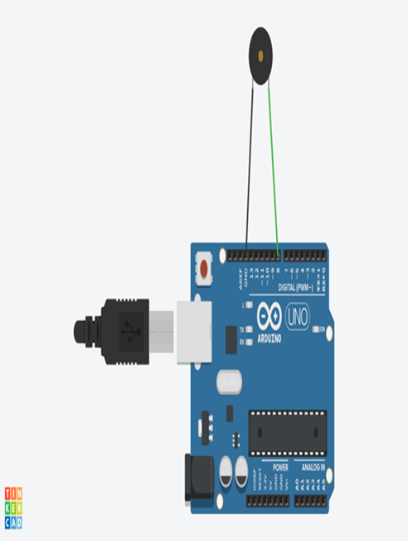
Step 3 : Arduino Working
When arduino get HIGH/1 signal from IR Sensor, At a same time it send signal to LCD and RELAY.
LCD display reverse count down time and RELAY gets HIGH/1 signal.
Step 4 : RELAY Working
When RELAY gets HIGH/1 signal from ardunio ,Current flowing through coil and it generates magnetic field .
Because of magnetic field COM is connected to NO & NC and circuit is completed. so, current is flowing from MAIN to RELAY and RELAY to ELECTRIC SWITCH util arduino send LOW/0 signal to RELAY.
Step 5 : Time Over Indication:
When count down time reach to 00:00:00 then arduino send HIGH/1 signal to BUZZER .
So, BUZZER beeps for 0.5 sec ,indicating that charging time is over.

Slide 20
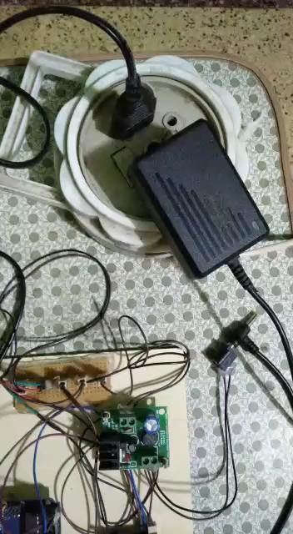

Slide 21
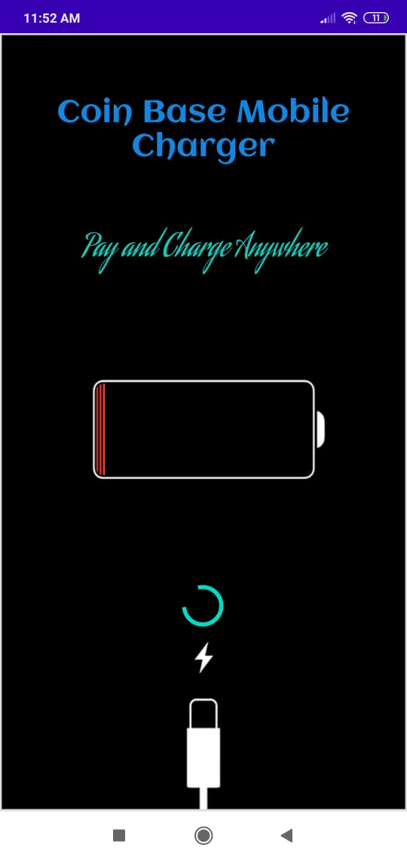
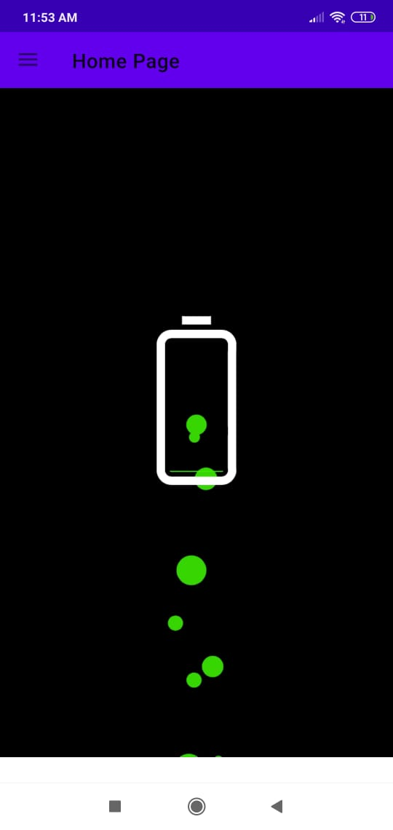
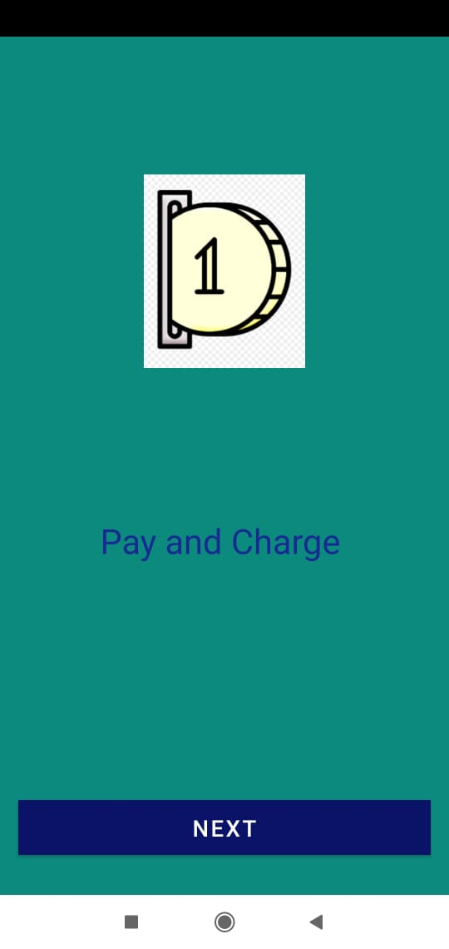

Supportive Android Application
Slash screen of App
Home Page with navigation Bar
Activity showing feature
Video tutorial for user

Slide 22
Benefits
Best in Emergency
If your mobile battery is low then no need to find any resources just use this device
User Friendly
Technical as well as non-technical people can easily access the device
Easy Installation
It has easy installation step so, can be easily install at any place where power supply is available
Way to business
By providing this facilities at railway station ,bus stop, colleges, mall; any one can explore it as business

Slide 23



Application
Railway station
Smart coin base charger can be installed on the railway station, where lot of people are waiting for their train during this time they can charge their phone .
Public place
The best place for this project is public place. Every time the people doesn’t carry Charger or any back up so in emergency it will help
‹#›

Slide 24
Future Scope
Use the solar plate for the input power supply
Use of coin acceptor to get coin
Use of GPS to find the station of this device
Use of online payment method
Use of android app to get location of device

Slide 25
Conclusion
After overall deployment and testing of our project (including Hardware and Software) thus we have concluded that , we successfully satisfied the expected requirements of the utility of coin base mobile charge.
we have generated the results of a create-and-design research aimed at providing a Coin Based Mobile Charger using Arduino, Coin Sensor and relay.
This plays a vital role in charging the mobile phones. it will be very useful and can be implemented in many areas.

Slide 26
References
www.arduino.cc
github.com
engineersgarage.com
instructables.com
www.slideshare.com

Slide 27
Thank You !
From Team
Coin Base Mobile Charger

